Slide 1


Pearson Webcast Series

Slide 2

About Us
Pearson
We are the world's largest education company, with 40,000 employees in more than 70 countries helping people of all ages to make measurable progress in their lives. We have a simple mission: to help people make more of their lives through learning.
Pearson IT Certification
Pearson IT Certification is a leader in IT Certification learning solutions, with a long tradition of delivering proven learning tools and educational training materials that have helped instructors teach, students learn, and certification exam candidates succeed.
.
Brought to you by Pearson IT Certification – pearsonitcertification.com/webcasts
Pearson IT Certification is the online presence of the family of information technology publishers and brands of Pearson

Slide 3
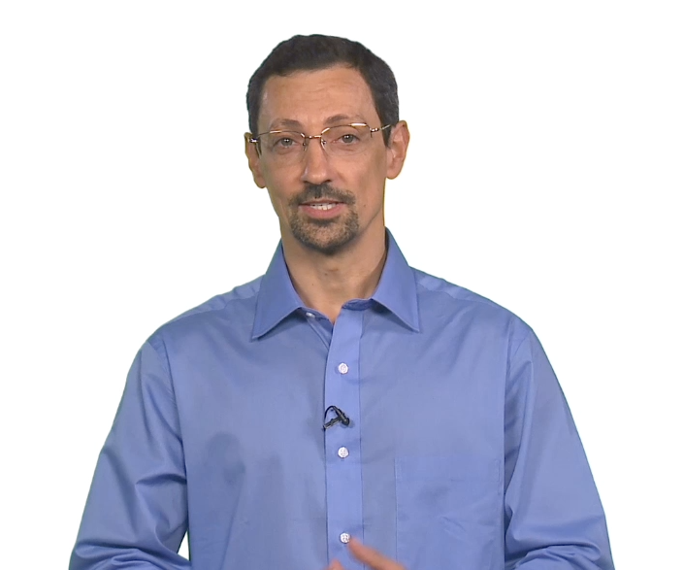

New CCNA Wireless: Learn the topics and the architectures
Replace with Author picture
Replace w/ Product
Presented by Jerome Henry
Brought to you by Pearson IT Certification – pearsonitcertification.com/webcasts
Pearson IT Certification is the online presence of the family of information technology publishers and brands of Pearson

Slide 4
CCNA Wireless v3.0
What’s in there, what’s new from v2.0
RF fundamentals (13%)
  Waves, RSSI/SNR, dB, antennas
802.11 fundamentals (13%)
  IEEE, WFA, FCC/ETSI/Others, 802.11a/b/g/n/ac, frames, topologies
Implementing a Wireless Network (16%)
  Centralized, Converged Access, Cloud, components, AP/WLC management options

Slide 5
CCNA Wireless v3.0
What’s in there, what’s new from v2.0
Operating a Wireless Network (20%)
  WLC setup, AP, WLAN, code, configuration management
Configuration of Client Connectivity (16%)
  Windows, Apple OS X, IOS, Android
Performing Client Connectivity Troubleshooting (13%)
  AP, WLAN, switch configs, logs, UI screens
Site Survey Process (9%)
  Site survey types, tools and processes

Slide 6
IOS-XE, AireOS, Converged Access, Centralized architectures, PoA, PoP…
What are the differences? How much do you need to know?

Slide 7

AP Control Options
Autonomous

Slide 8

AP Control Options
Controller-based
CAPWAP

Slide 9
Controller as a Function
AP
Router
Appliance (physical, virtual)
Switch
Cloud

Slide 10

APs and Controllers
Centralized

Slide 11


FlexConnect
Branches
Main Campus

Slide 12
Cloud (Meraki)
Branches
Dashboard

Slide 13
APs and Controllers
Centralized

Slide 14


APs and Controllers
Centralized

Slide 15

APs and Controllers
Converged
Access

Slide 16

Mobility Agent
MA

Slide 17
Mobility Controller
MC
PMK,
QoS, Security

Slide 18
MA, MC
MA, MC
AireOS
(2500, vWLC, 5500, 7500, 8500)
IOS XE 5760

Slide 19
MA, MC
MA
MC
IOS XE 3650, 3850, 4500E
AireOS
(2500, vWLC, 5500, 7500, 8500)
IOS XE 5760

Slide 20
What about PoA, PoP?…
Let’s switch to our blackboard.

Slide 21






PoA

Slide 22
PoA

Slide 23
PoP
PoA

Slide 24

PoP
PoA
WLAN A
VLAN 5
WLAN A
VLAN 5
Layer 2 Roam

Slide 25
PoP
PoA
WLAN A
VLAN 5
WLAN A
VLAN 10
Layer 3 Roam

Slide 26
Client context
Client context
PoP
Anchor
Foreign
PoA
WLAN A
VLAN 5
WLAN A
VLAN 10
Layer 3 Roam

Slide 27

Mobility Group
Mobility Group
Sub-Domain #1
Sub-Domain #2
SPG
SPG
PoP
PoA

Slide 28
Mobility Group
Mobility Group
PoP
PoA

Slide 29
802.11 fundamentals
802.11ac fun facts

Slide 30
802.11n/802.11ac 20 MHz
64 small waves (called Carriers, or Tones), using BPSK, QPSK… or QAM (Quadrature )
8 null, 4 pilots (+-7, +-21) -> 52 active tones
No power, help isolate
against neighboring channels
No power, help isolate
against neighboring channels
“guides”
to help evaluate channel noise
7% pilots

Slide 31
802.11n/802.11ac 40 MHz
  128 subcarriers (vs. 64)
  14 (vs. 12/8) zero subcarriers on sides (6;5) and center (3)
  6 pilot subcarriers (vs. 4): +-11, +-25, +-53
  108 data subcarriers (vs. 48/52)
+
=
5% pilots, 2.3x 802.11a/g capacity

Slide 32
802.11ac 80 MHz
  256 subcarriers (vs. 128)
  Still 14 zero subcarriers on sides (6;5) and center (3)
  8 pilot subcarriers (vs. 6): +-11, +-39, +-75, +-103
  234 data subcarriers (vs. 108)
+
=
3% pilots, 4.9x 802.11a/g capacity, 2.15x 11n/ac 40 MHz capacity

Slide 33
802.11ac 160 MHz
  512 subcarriers (vs. 256)
  28 zero subcarriers
  16 pilot subcarriers (vs. 8): +-25, +-53, +-89, +-117, +-139, +-167, +-203, +-231
  468 data subcarriers (vs. 234)
+
=
6 bottom at 0
(no difference)
-129 to -127
at 0
-5 to +5
at 0
+127 to +129
at 0
5 top at 0
(no difference)
3% pilots, 9.75x 802.11a/g capacity, 2x 11ac 80 MHz capacity

Slide 34
Is spectrum available for wide channels?
Not yet, but it is coming
Channel #
36
40
44
48
52
56
60
64
68
72
76
80
84
88
92
96
100
104
108
112
116
120
124
128
132
136
140
144
149
153
157
161
165
169
173
177
181
20 MHz
40 MHz
80 MHz
160 MHz
UNII-1
UNII-2
UNII-2 Extended
UNII-3
5250
MHz
5350
MHz
5470
MHz
5725
MHz
5825
MHz
5925
MHz
Available
Radar affected
To become available

Slide 35
Some 802.11ac Rx Sensitivity
MCS | Channel | SS | Data Rate (NGI) | RSSI Min | SNR Min
7 | 20 MHz | 1 | 65 | 76.5 | 17.5
7 | 40 MHz | 1 | 135 | 74.5 | 19.5
7 | 80 MHz | 1 | 292.5 | 71.5 | 22.5
7 | 20 MHz | 3 | 195 | 71 | 23
7 | 40 MHz | 3 | 405 | 71 | 23
7 | 80 MHz | 3 | 1053 | 63 | 31
You need 5 dB more to read a 80 MHz 1SS signal than to read a 20 MHz 1SS signal
You need 8 dB more to read a 80 MHz 3SS signal than to read a 20 MHz 3SS signal
You need 8.5 dB more to read a 80 MHz 3SS signal than to read a 80 MHz 1SS signal

Slide 36
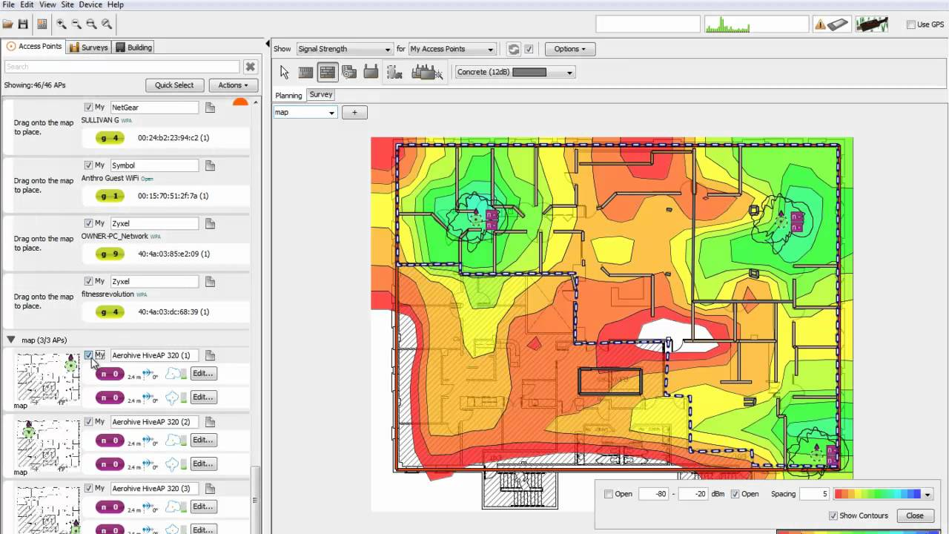
What else will you learn?
All about MU-MIMO
How to choose an antenna
How to perform a site survey
How to configure and troubleshoot
And much more….

Slide 37
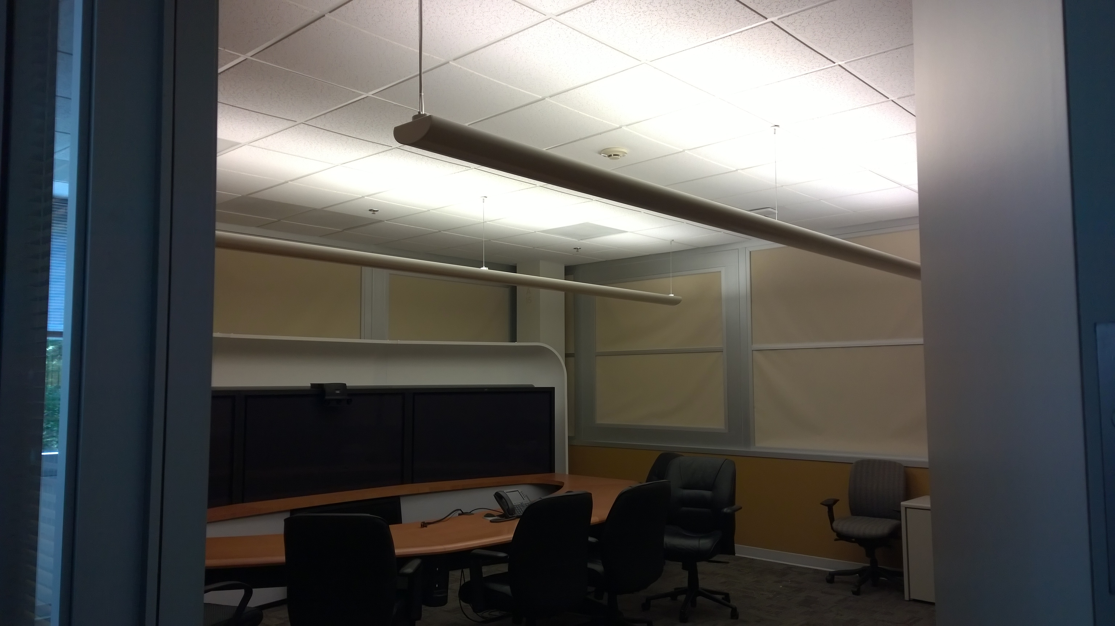
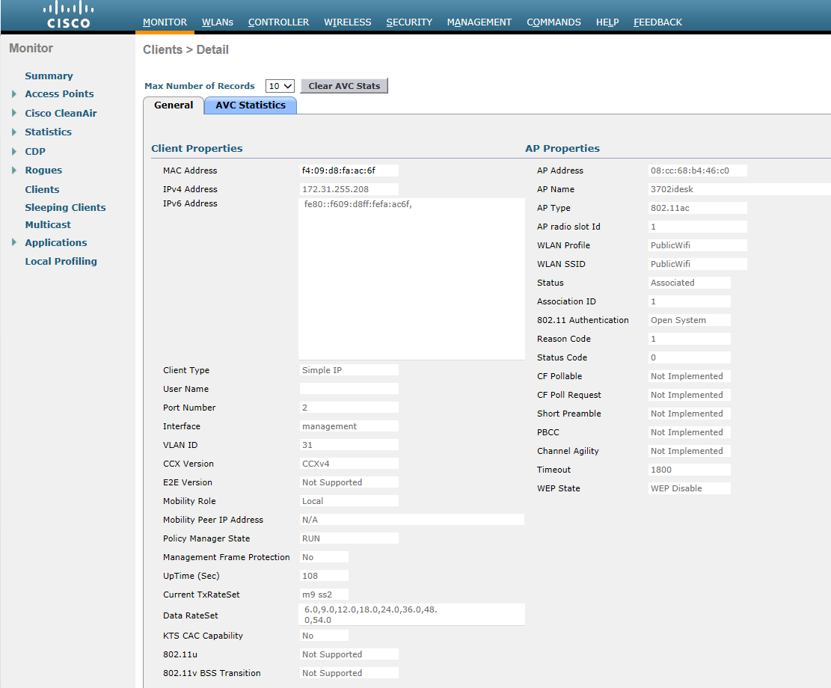
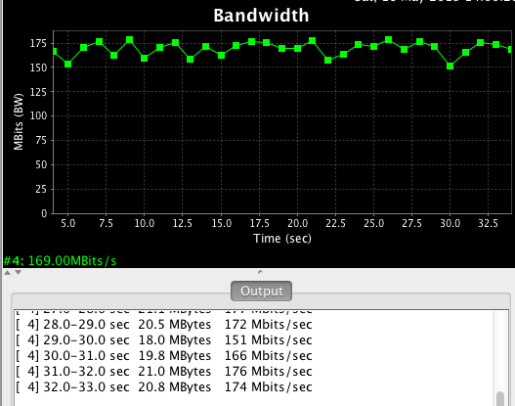

With Multipath
m9 ss2

Slide 38
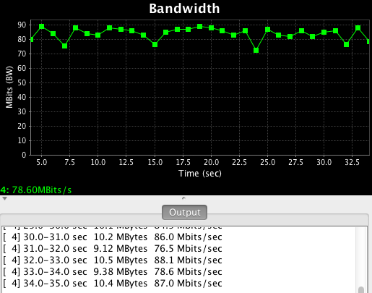
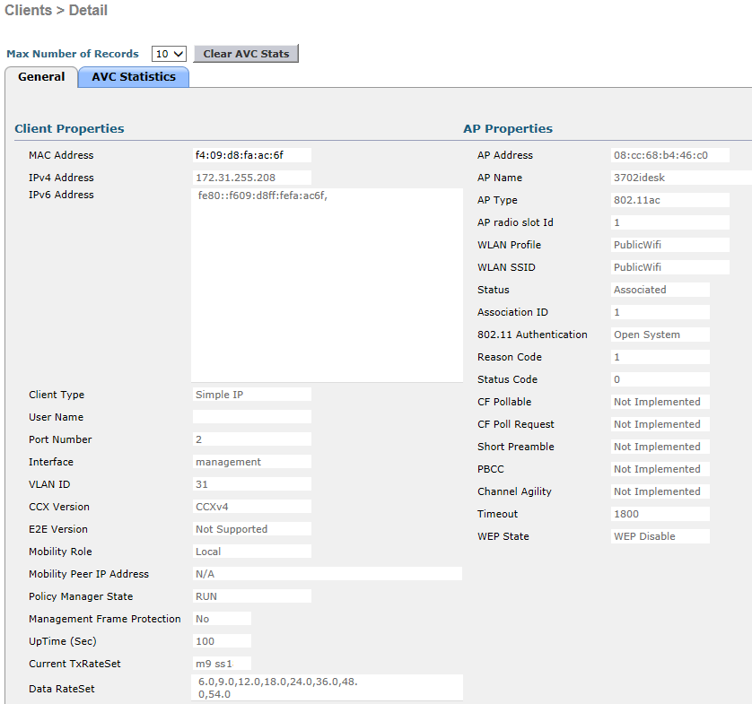
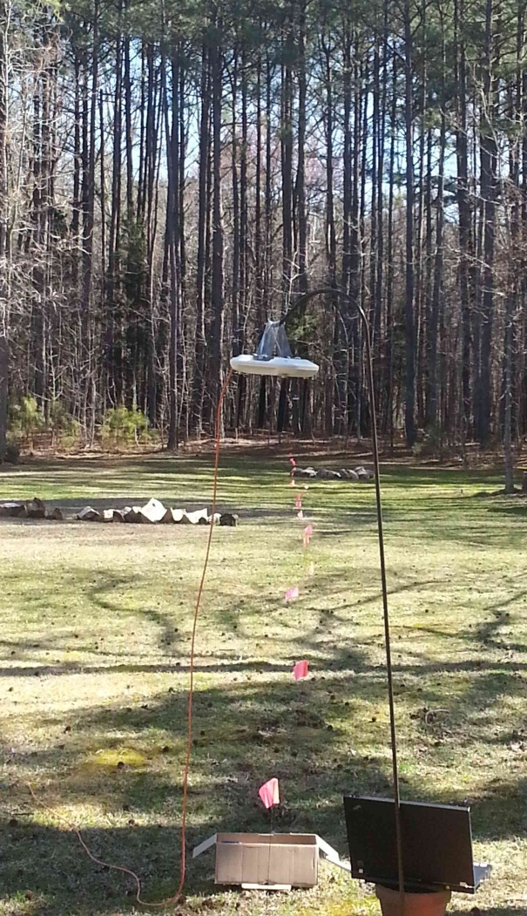
Without Multipath
Outdoor, multipath is not enough
for the phone to differentiate streams
m9 ss1

Slide 39
Additional Resources
Jerome Henry
jhenry@ieee.org
Website: http://wirelessccie.blogspot.com.co/
Facebook: er no, sorry
Twitter: #wirelessccie
GitHub: nope ☹

Slide 40

Thank you!
Sign-up for more webcasts at pearsonitcertification/webcasts
Connect with Pearson IT Certification at pearsonitcertification/community

