Slide 1
Moving Access Tables to SharePoint 2010 or SharePoint Online Lists
Presented by
Roger Jennings
quepublishing.com/jennings
Based on:
Chapter 22, “Collaborating with Windows Sharepoint Foundation 2010”
Chapter 23, “Sharing Web Databases with SharePoint Server 2010”
of Microsoft Access 2010 In Depth - ISBN-10 0-7897-4307-8
Notes:
30-second intro with music under fade out to 00:00:30

Slide 2
Moving Access Tables to SharePoint 2010 or SharePoint Online Lists
Presented by
Roger Jennings
quepublishing.com/jennings
If you don’t have at least Designer permissions for an on-premises SharePoint Foundation or SharePoint Server 2010 site, apply to join the Office 365 public beta’s personal Plan P1 program at http://www.microsoft.com/office365/.
Check out the Bibliography for My “Moving Access Tables to Sharepoint 2010 or SharePoint Online Lists” Webcast of 5/23/2011 blog post at http://bit.ly/lxCNFJ.
Mail your questions to roger_jennings@compuserve.com.
Notes:
Hello and welcome to the last of three Webinars about advanced Access 2010 techniques sponsored by Que Publishing.
I’m Roger Jennings, the author of Que’s Access 2010 In depth and curator of the Roger Jennings’ Access In Depth blog at http://accessindepth.blogspot.com. I’ll be your guide for the following 55 minutes or so of technical content. I’ll try to answer questions you send to roger_jennings@compuserve.com, the email alias at the end of the About the Author page.
By the time you finish today’s Webcast, you’ll know how to upsize Access tables to linked SharePoint Foundation or Server 2010 lists, join the beta testing program for Office 365 Business Edition’s SharePoint Online, create an Access Web Database from SharePoint Online’s Contacts Web Database template, and add users with read-only or read/write permissions for the Web Database.
Be sure to write down the URL for the detailed bibliography of articles about moving and linking Access tables to SharePoint 2010 or SharePoint Online lists.
If you’ve registered, you’ll be able to participate in Que’s post-event survey to provide feedback on this Webcast and enter a sweepstakes with a free book as the prize.

Slide 3
Welcome – Our Agenda Today
Create an on-premises SharePoint site to hold lists linked to Access tables.
Move and link an Access application’s tables to on-premises SharePoint lists with a wizard.
Synchronize lists in a local SharePoint Workspace with the master SharePoint list data
Create a Contacts Access Web Database from a built-in SharePoint Online template.
Write an Access Client Query to append new rows to the Contacts Web database.
Add new user (subscriber) accounts to sub-sites of a SharePoint Online TeamSite.
Enable read-only or read-write user permissions by membership in the sub-site’s Visitors or Members groups.
Mail your questions to roger_jennings@compuserve.com.
Notes:
We’ll start with a brief description of SharePoint Foundation and Server 2010 architecture. Next comes the pros and cons, followed by an examination of restrictions on and performance issues with Access tables linked to SharePoint lists.
A tutorial for moving the tables of a moderately complex variant of the Northwind sample database to SharePoint Foundation 2010 follows. You’ll also learn how to modify designs in Access and create a local SharePoint Workspace that synchronizes local data updates with SharePoint lists.
Office 365’s SharePoint Online include five simple templates for creating Web databases for users that don’t have Access 2010. You learn to create a Contacts subsite from a template and use an Access Client Query to append new rows to the Contacts list in bulk.
Finally, you’ll learn how to add new subscriber accounts to the Contacts subsite and grant them read-only or read-write permissions using built-in Visitors or Members groups.

Slide 4
SharePoint 2010 Architecture
Image from Microsoft
Notes:
Here’s a SharePoint 2010 Server architectural diagram from Microsoft that describes the available services. SharePoint Server 2010 replaces Microsoft Office SharePoint Services, usually call MOSS.
Excel Calc Services and InfoPath Services support Web front ends for these two Office apps. Similarly, Access Services provides the Web front end for Access 2010.
SharePoint Foundation is a free upgrade to Windows Server 2008 R2 that replaces Windows SharePoint Services 3.0. WSS 3.0 provided back-end support for SharePoint lists linked to Access 2007 tables. This third member of my Webinar series shows you how to move and synchronize Access tables to SharePoint Foundation lists.
Full SharePoint Server 2010 and Office 365 Small Business Subscriptions provide Access Services for creating Web databases, which this Webcast also covers.

Slide 5
Why Use SharePoint with Access?
Linking Access front ends to SharePoint lists enables simplified security for multiple users
On-premises SharePoint Foundation or Server 2010 can use Active Directory for authentication
SharePoint users can update data in a familiar environment and synchronize their changes
IT personnel are responsible for backing up linked SharePoint lists and Web Databases
Low-cost Office 365 Small Business provides 99.9% availability and backups every 12 hours
SharePoint Server 2010 and Office 365 offer Access Services for publishing Web Databases
Notes:
If you’ve used Access 2003 or 2007, you’re probably aware of their capability to export Access tables to SharePoint lists. They let you link and synchronize the Access front to the lists so Access forms and reports reflect recent data changes made by SharePoint users.
Access 2010 takes this capability one step further by letting you migrate Access queries, forms, reports and macros to Access Services running on SharePoint 2010. This means that SharePoint users can view and edit data in a browser with forms that closely resemble familiar Access desktop forms. They can also export reports to common document formats or print them to local and network printers. Publishing Web Databases from Access to SharePoint was the subject of the first Webcast in this series. We’ll reverse the process in today’s Webcast.
Web Databases are a welcome replacement for the earlier Data Access Pages that few Access users will miss. DAPs were difficult to design and almost impossible to deploy securely to the public Internet. As you’ll see later, you can create a SharePoint Web Database hosted by SharePoint Online.

Slide 6
How to Link Tables to SharePoint Lists
In the Database Tools tab’s Move Data group, click the SharePoint icon to start the Export Tables to SharePoint Wizard.
In the Create tab’s Tables group, open the SharePoint Lists menu to create a new SharePoint list from a prebuilt template and link it.
In the External Data tab’s Import & Link group, open the More menu and select SharePoint List to open a dialog that lets you select the list to link.
All choices require access to a SharePoint site or SharePoint Online and at least Design permissions.
Notes:
Here are the approaches you can choose from to move and link Access tables, create and link new SharePoint lists or link to an existing SharePoint list.
You’re better off using an account with administrator permissions for the site, which are required to manage users and groups.

Slide 7
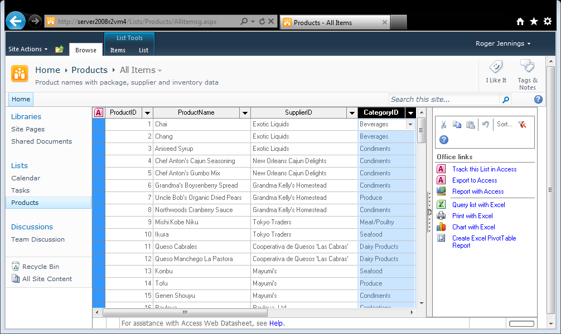
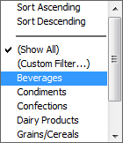
A Products Table Upsized to a List
Lookup Fields
Notes:
Access 2003 introduced the Lookup field data type to emulate one-to-many table relationships in SharePoint lists.
Access 2007 added the Multivalued Lookup Field feature, abbreviated MVLF, to support many-to-many relationships, such as multiple Suppliers for a particular Product.

Slide 8
SharePoint Lists Don’t Support:
Primary keys other than Long Integer
Table and column names that are the same as SharePoint reserved words or contain spaces
Composite indexes, e.g., Order Details index on OrderID + ProductID
More than one no-duplicate index
Indexes on Attachment or Lookup columns
Lookup columns whose source table field isn’t a Long Integer primary key
Autonumber fields other than for the primary key
Autonumber fields that start with a number > 1
Notes:
SharePoint lists also have many limitations that don’t apply to Access tables.
In some cases, you’ll need to redesign your database schema to suit SharePoint lists’ restrictions. On the whole, it’s much easier if you start your table designs with a future move to SharePoint in mind.
For example, you must add an autoincrementing surrogate primary key to tables that use natural primary keys, such as the original Northwind Customer table’s five-character CustomerID field (e.g., ALFKI).
You’ll also need to replace joins, which SharePoint lists don’t support, to reference tables with Lookup columns. That isn’t always a simple task.

Slide 9
SharePoint List Data Types
Single or multiple line(s) of text
Choice (with menu to choose from choices)
Number (such as 1, 1.0, 100)
Currency ($, Yen or Euro)
Date and Time
Lookup (to existing list items)
Yes/No (check box)
Person or Group
Hyperlink or Picture
Calculated
Business Data (Business Connectivity Service)
Notes:
SharePoint stores list data in a local instance of SQL Server, usually the Express edition. However, SharePoint lists have a much more limited data type repertoire than SQL Server.
The Business Connectivity Service (BCS) handles strongly typed data delivered from XML Web services. Office 365 Small Business Edition’s SharePoint Online doesn’t support BCS.

Slide 10
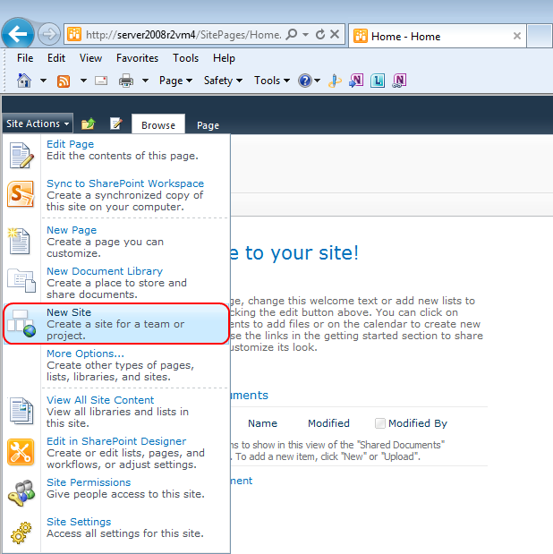
Create a Site for the Access Tables
If you have Administrator
Permissions for a Share-
Point Foundation or Server
2010 instance, log into the
site, open the Site Actions
Menu and choose New Site.
Otherwise, ask your organ-
Ization’s SharePoint admini-
Strator to create a new site
with a name related to the
database name.
Notes:
It’s a good practice to dedicate a SharePoint site or sub-site to the tables of a single database. If some of your tables fail to move as expected, it’s much easier to delete and recreate the site or sub-site than to add individual tables manually after fixing the problems. Deleting tables with lookup columns can be very time consuming or, in some cases, virtually impossible.

Slide 11
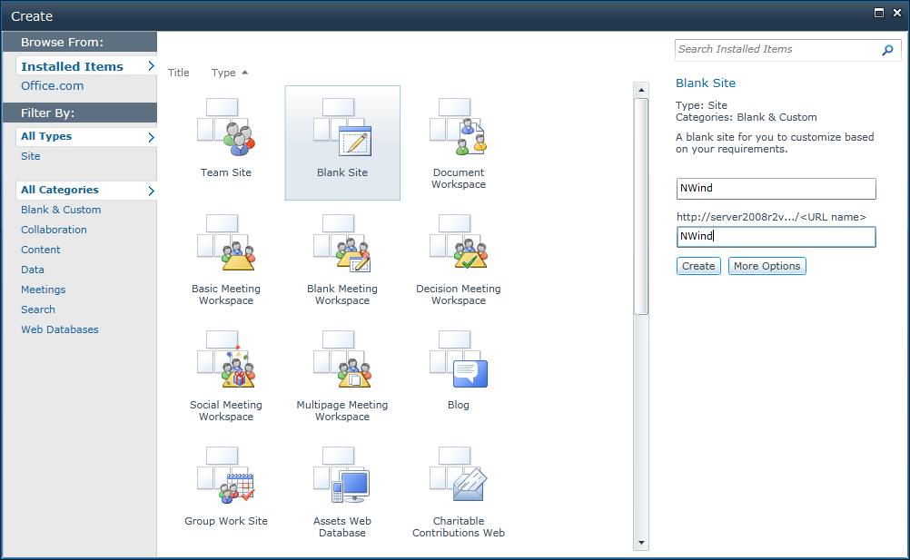
Specify the Site Name and URL
Notes:
In most cases, the site you specify to store lists linked to Access tables doesn’t need the additional overhead required to support Document or other Workspaces. You’ll use a template for a Web Database later in the Webcast.
The first step in creating a new site is to specify it’s name and URL suffix, NWind for this example. URL’s aren’t case sensitive.

Slide 12
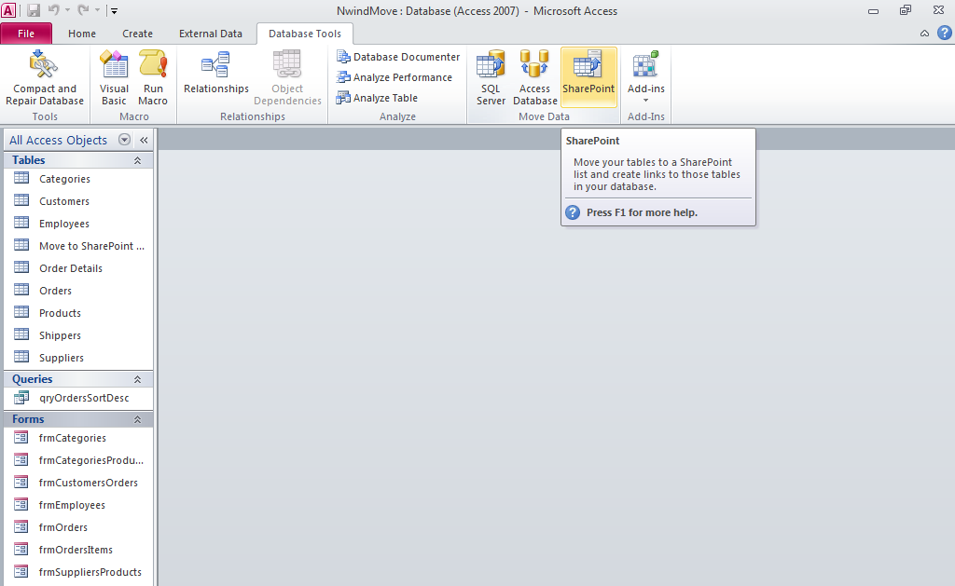
Start the SharePoint Wizard
Click the Database Tools tab and the Sharepoint button.
Notes:
Start the SharePoint Wizard by selecting the Database Tools tab and clicking the Move Data group’s SharePoint icon.

Slide 13
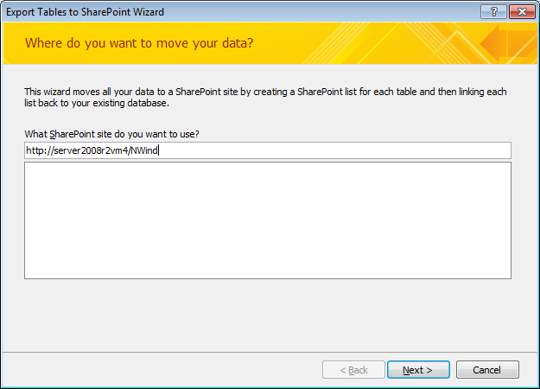
Specify a SharePoint Sub-Site URL
Notes:
Type the full URL, consisting of the SharePoint instance address, the server name for this example, and the site name suffix you just assigned. Click next to start moving the tables.

Slide 14
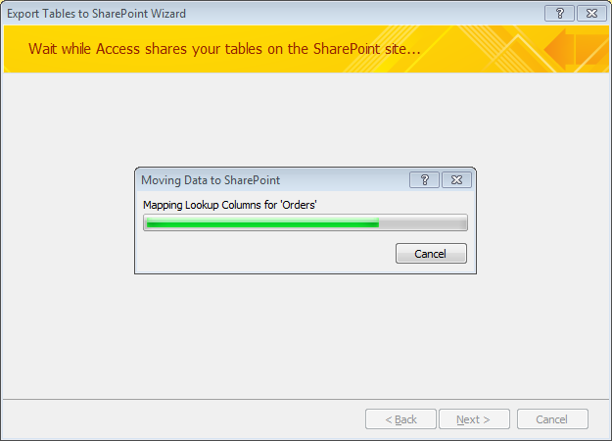
Observe Upsizing Progress
Notes:
Depending on the number of tables and amount of data they contain, it might take a few minutes to complete the linking process. The Moving Data to SharePoint message box indicates each step.

Slide 15
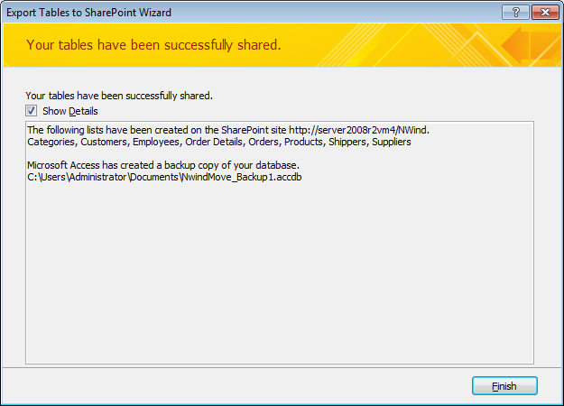
Review Upsizing Details
Notes:
When the tables have moved to the SharePoint site successfully, the Wizard backs up the database and then links the lists to the local Access application.

Slide 16
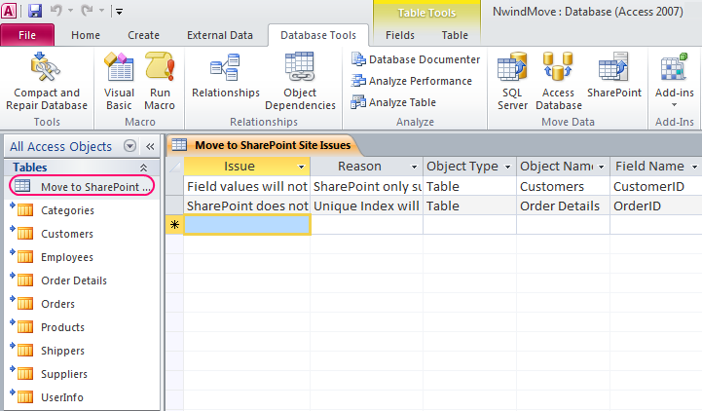
Check Move to SharePoint Site Issues
CustomerID: Field values will not be auto-generated. SharePoint
only supports AutoNumber for their ID field.
OrderID: SharePoint does not support unique indexes on any column
other than ID. Unique Index will not be enforced.
Notes:
If no critical errors are encountered in the move, the Access application replaces Table with SharePoint icons and adds a move to SharePoint Site Issues table if the developer needs information to implement workarounds. In this case, adding a new Customer record will increment a new ID column but not add a five-character CustomerID value. The unique composite index on OrderID and ProductID, which prevents two records for the same product in the Order Details table, is missing. If you want to maintain this constraint, you’ll need to add a workaround.

Slide 17
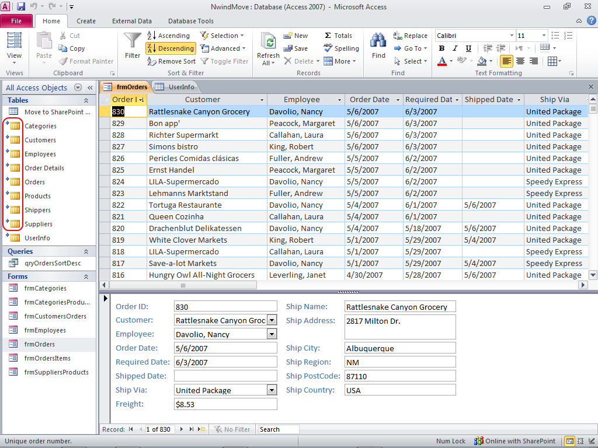
Open a Form to Test the Lists
Notes:
The autonumber OrderID primary key field must start with one to comply with SharePoint’s requirement for 1-based autoincrementing columns. This restriction can be a major pain for real-world applications, where a row is an abstraction of a serially numbered document, such as an invoice. SharePoint will autogenerate an _OldID system column that contains the previous primary key values, but you’ll need to fix up look up columns that rely on original primary key values, such as this example’s Order Details records.

Slide 18
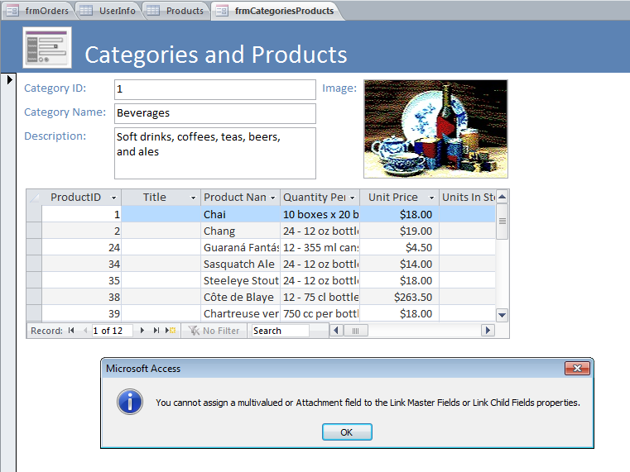
You Can’t Link Datasheets on Multi- Valued Lookup or Attachment Fields
Notes:
Access forms and reports won’t accept multi-valued lookup fields for links that create master-child forms or reports. In this case, some products have two or more suppliers, which requires a multi-valued lookup SupplierID field. You’ll need to write a workaround macro to link the master and child forms. Unfortunately, Web Databases don’t support VBA code.

Slide 19
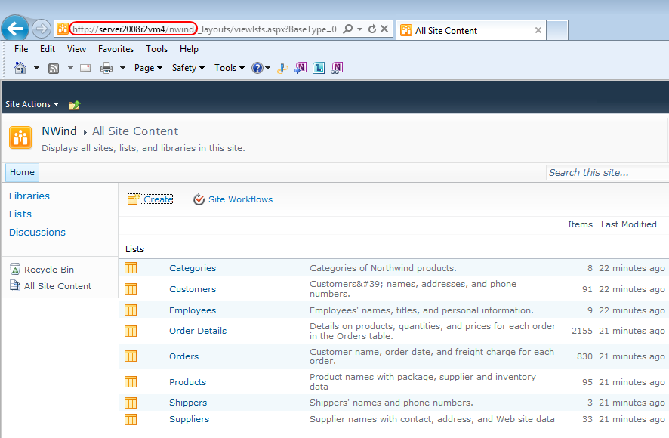
Open Lists in SharePoint
Notes:
SharePoint’s Lists page contains a link to each list you move from the Access application. Double-click a link to open the list in a SharePoint Web Datasheet, the default display for tables moved from Access.

Slide 20
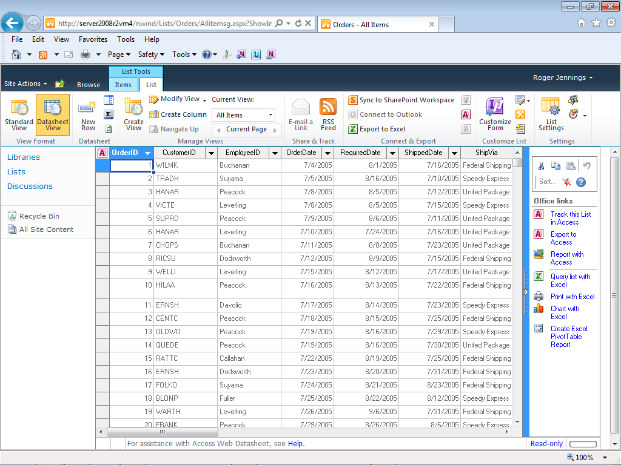
View a List in Web Datasheet View
Notes:
SharePoint Web datasheets have an Office Links gallery with shortcuts to common actions. No Access-related actions are applicable to this example, because the lists originated in an Access application, which presumably already has reports designed.

Slide 21
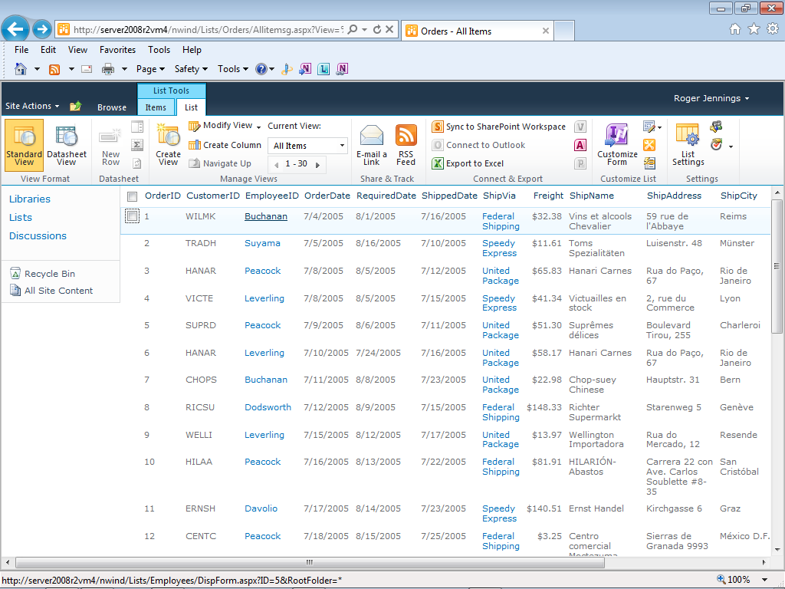
Standard View of the Orders List
Notes:
Clicking the View Format group’s Standard View button displays a classic SharePoint view of the list. EmployeeID and ShipVia columns have links to open an editing view of the related Lookup cell. CustomerID doesn’t have lookup links because SharePoint won’t generate a Lookup column to a table whose original primary key wasn’t of the long integer data type.

Slide 22
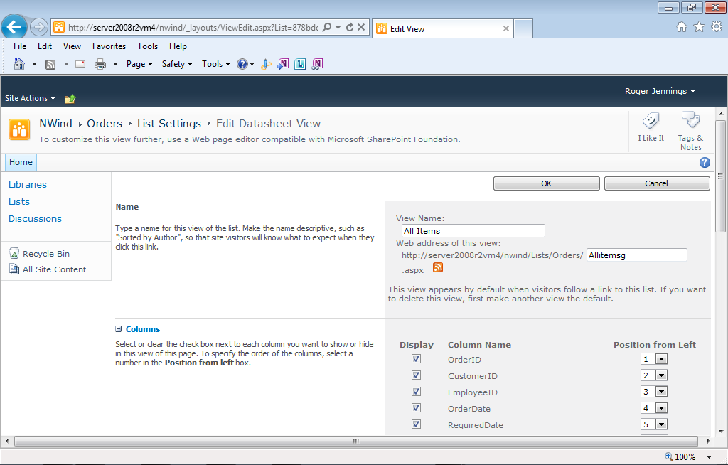
Customizing List Settings
Click the Modify View button to open an editing page for the default All Items
list view, which enables editing visible columns and their position, specifying
a sort order and filter, columns with totals, and how to display item folders:
Notes:
The Edit Datasheet View page for a list lets you change the visibility of generated and system columns, alter the sequence in which the columns appear, specify a non-default sort order, apply a filter, designate which rows should display total values, and how to display cells which contain folders of items.

Slide 23
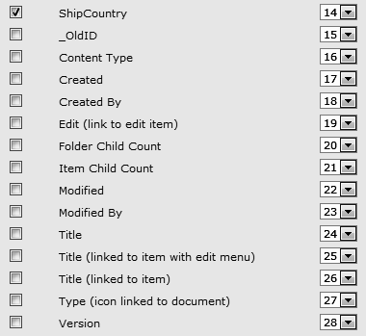
Discovering Hidden List Columns
All SharePoint lists have 14 system columns, which are hidden by default.
Displaying a hidden column and setting its position increments all columns
with greater position values.
Notes:
Most of SharePoint’s 14 system columns are for compatibility with earlier versions and are hidden by default. You might need to expose the _OldID column if the table you moved had a long integer primary key that didn’t start with the number 1. You also need to expose and fill in the Title column to simplify viewing and editing lists in SharePoint Workspaces.

Slide 24
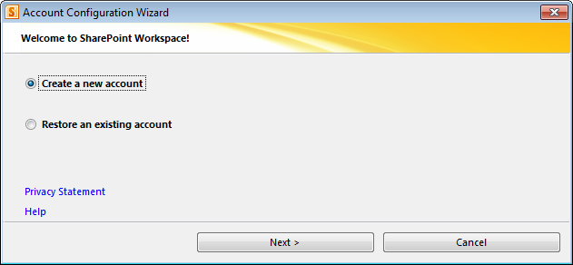
Create and Sync a SharePoint Workspace on Your Computer
SharePoint 2010 Workspaces provide direct bi-directional synchronization
of library and list content between a SharePoint site and a workspace on
an individual client computer.
Open the Site Actions menu and choose Sync To SharePoint Workspace
to start the Account Configuration Wizard:
Notes:
Microsoft Office 2010 Professional Plus includes SharePoint Workspace, which lets you save SharePoint 2010 or Online content to your local computer, disconnect from your organization’s network or the Internet, make changes to the local content, and synchronize the changes with the SharePoint server when you reconnect. Changes made by others while you’re disconnected synchronize back to your local copies.
Office 2010 Professional Plus is available only through Microsoft Volume Licensing, which requires purchase of five or more Office 2010 licenses.

Slide 25
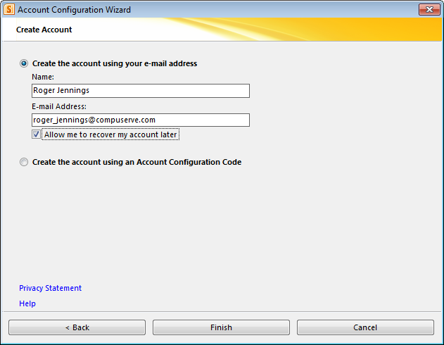
Specify Workspace Account Details
Notes:
The most common authentication method for a Workspace account is your e-mail address.

Slide 26
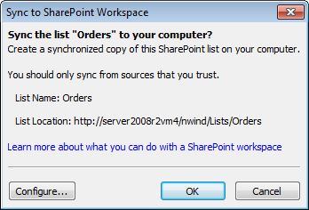
Prepare to Configure the Workspace
After you’ve set up your account, the Sync to SharePoint Workspace
dialog appears when you click the link on the SharePoint page.
Notes:
After you configure your SharePoint Workspace account, you can change its configuration in the Sync to Sharepoint Workspace dialog by clicking the Configure button.

Slide 27
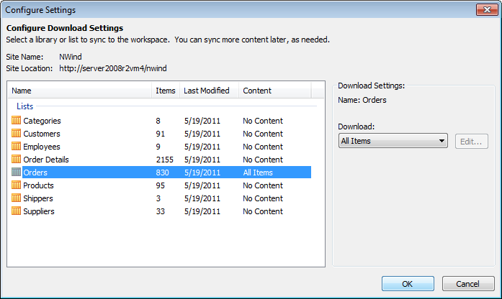
Configure Sync’d Lists
Notes:
You can select any SharePoint list or library for synchronization by selecting it in the Configure Settings list and specifying a Download option.

Slide 28
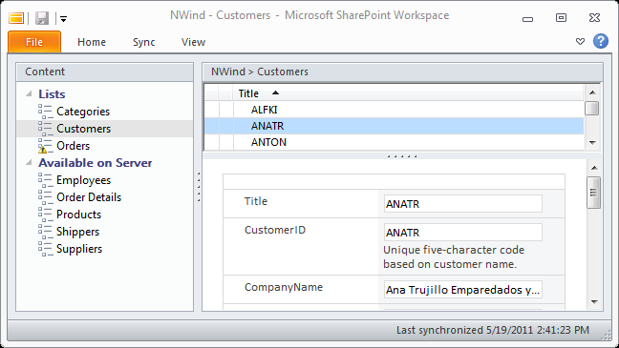
Customers Sync’d to Workspace
List items require Title values for selection of item to edit.
Notes:
The Orders table has a synchronization problem due to conflicts with the OrderID primary key, which doesn’t start with the number 1. If you want to select items by name to view or edit in the upper list, you must manually enter the Title values or design a SharePoint workflow to handle the task. Designing SharePoint workflows is beyond the scope of this Webcast.

Slide 29
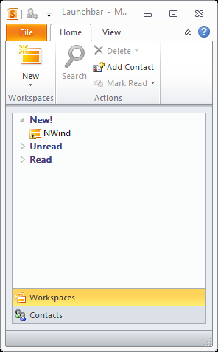
Launching Share- Point Workspace
Choose Start, All Programs, Microsoft Office, Microsoft SharePoint Workspace to open the Launchbar in Safe Mode due to error in Orders sync.
Double-clicking a Workspace icon opens a warning about Safe Mode restrictions.
Notes:
SharePoint Workspace has a Launchbar, which runs by default when you start your computer. The Launchbar includes lists of synchronized lists, libraries and contacts.

Slide 30
Office 365 SharePoint Online Features in Small Business Plan P1
One Team Site and one simple public-facing site
Site Designer for editing the public-facing site
Access Services for generating Web Databases
One Sub-Site Collection
View and edit capabilities for Office Web Apps
10 GB basic online storage, plus 500 MB per licensed user, with data backup services
Up to 50 organization users
Users can synchronize SharePoint Online libraries and lists to their computers
Notes:
If your organization doesn’t run SharePoint Foundation or SharePoint Server 2010, or your IT department won’t assign you a SharePoint site or sub-site for use with Access 2010, consider a $6.00 per month subscription to Office 365 Small Business edition. Bear in mind that each user of your site or sub-site must also have an Office 365 subscription.
External users don’t need a subscription, but Office 365 Business Edition Beta doesn’t appear to support external users.

Slide 31
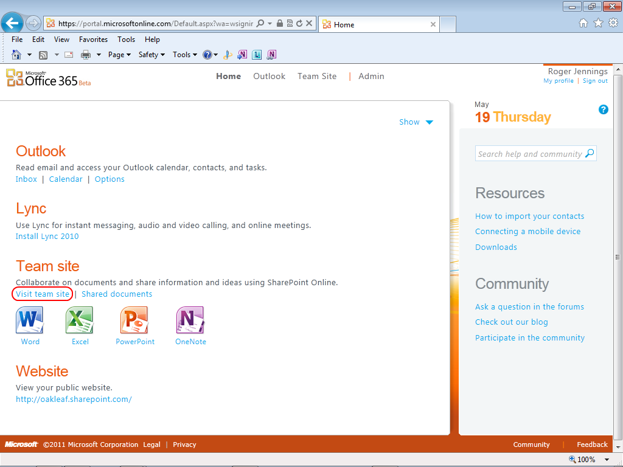
Set Up Office 365 Beta
Notes:
When you receive an e-mail that your Office 365 beta account has been approved, follow the instructions in the message to log into the Microsoft Online portal at https://portal.microsoftonline.com. Complete the initial site setup by specifying a domain name, which must be unique. oakleaf.sharepoint.com is the domain for this Webcast’s online examples. Click the Visit Team Site link to open the empty TeamSite.

Slide 32
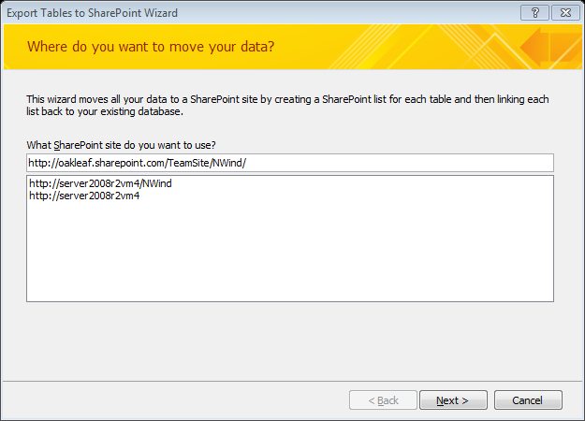
Specify the Sub-Site’s Full URL
The sub-site URL is http://oakleaf.sharepoint.com/TeamSite/NWind
Notes:
Click the Database Tools tab and the SharePoint icon in the Move Data group to start the Export Tables to SharePoint Wizard. Add the name of the sub-site to create as a suffix to the TeamSite’s URL. From this point on, operations with linked tables are the same as those linked to an on-premises site.

Slide 33
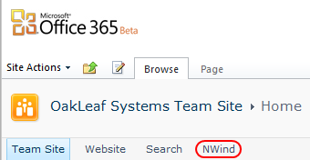
Opening Sub-sites
Links to sub-sites appear to the right of the parent site:
Notes:
The Team Site is the parent site for this example.

Slide 34
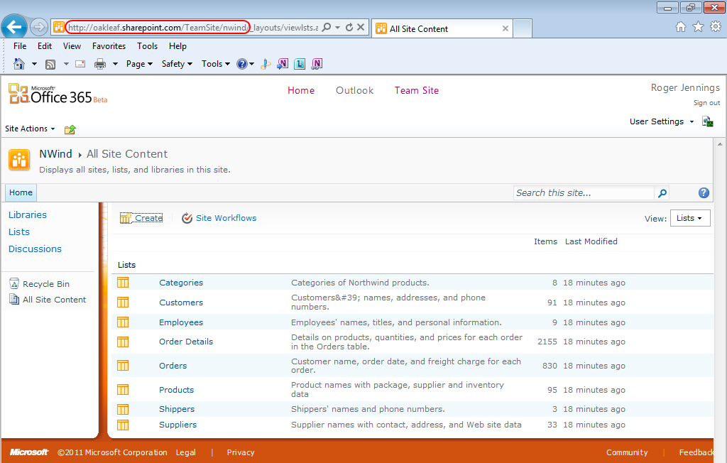
The Sub-Site with Lists Added

Slide 35
What Are Access Web Databases?
Applications that enable users to view, print, add, edit or delete Access data with a Web browser
Replacements for Data Access Pages (DAPs) of Access 2003 and earlier
Allow anywhere, anytime interaction with your data when deployed to Internet-facing SharePoint Server
Protect your data with Windows or Live ID logins for authentication and authorization – no public access
Delivered by Access Services from on-premises or hosted SharePoint Server 2010 Enterprise Edition or Office 365’s SharePoint Online
Created from Access 2010 or SharePoint 2010/Online
Notes:
At this point you’ve learned how to move Access tables to SharePoint lists and then link and synchronize the Access front end with changes made to data by the lists users. The remainder of this Webcast is devoted to Access Web Databases that you create with SharePoint Server 2010 or SharePoint Online, rather than with Access 2010. The example uses SharePoint online, but the process is almost identical with on-premises SharePoint Server 2010.
An alternative to using

Slide 36
Web Database Benefits
Extend the reach of Access applications to business partners, customers, telecommuters, salespersons
Use Windows security with on-premises and hosted SharePoint; Office 365 uses subscriber logins.
Granular authorization: View Only, Read, Contribute, Design, Full Control permissions for user accounts
Easy deployment: Design changes you make to a single instance apply to all users of the application
Create tables, queries, forms, reports and macros with desktop Access; a Wizard publishes to the Web
If you don’t have Access 2010, you can create Web Databases from SharePoint Online templates.
Notes:
These are the most important benefits that Access Web Databases deliver to ordinary Access users and power users.
Professional Access developers can develop a substantial new revenue stream by setting up SharePoint online and hosted or on-premises SharePoint Server 2010 servers, as well as creating new or upgrading existing applications to Web Databases.
Web Databases enable Access 2010 to compete with Intuit’s QuickBase and FileMaker’s FileMaker Pro11 Web applications.

Slide 37
Web Database Drawbacks
On-premises (intranet) SharePoint 2010 installation requires the Standard edition license (US$4,926)
Each intranet user requires a Standard (US$95) and Enterprise Client Access License (ECAL, US$83)
Internet access requires SharePoint 2010 for Internet Sites (US$11,793); user CALS are required if any content is restricted to company users only
Note that Office 365 solves the fixed cost problem
Other tables linked to Access aren’t supported
VBA isn’t supported; use macros for programming
Relationships aren’t supported; use Lookup Fields
Notes:
Here’s the bad news. For starters, SharePoint 2010 Server licenses aren’t cheap.
Fortunately, Office 365’s SharePoint on line and hosted SharePoint Server instances are low in cost, as you’ll see shortly.
I’m a long-time Visual Basic fan, so I miss VBA in Web Databases. However, new Access data macros provide some compensation for loss of VBA capabilities.
Lookup fields support one-to-many and many-to-many relationships in SharePoint lists. Access 2007 introduced lookup fields to support tables linked to SharePoint lists.

Slide 38
Web Database Performance
SharePoint lists are stored in SQL Server but don’t have offer SQL Server’s performance.
Access Services provides middle-tier data caching (storage in memory) to improve performance.
Microsoft recommends that Web Databases contain no more than three lists with up to 20,000 items (rows) each or no more than 20 lists with up to 1,000 items each.
A primary table with up to 10,000 rows and up to 20 secondary tables with less than 1,000 items each provides the best performance.
Response is affected by your ISP’s download rate.
Notes:
You’ll miss the snappy performance of desktop Access when you migrate applications to Web Databases.
Minimizing the number of list items downloaded when opening forms by using parameterized queries as form data sources and paging rows into datasheets improves performance.
If you need high performance with very large tables, you’re better off by upsizing to SQL Server or cloud-based SQL Azure. This is the subject of the second Webinar in this series,

Slide 39
Creating a Web Database from a SharePoint Online Template
Choosing New Site from the Site Actions menu and clicking the Browse All tab opens a page with new SharePoint site and Web Database templates.
Clicking the Web Database link in the left frame displays five icons for Web Database Templates:
Download the GroupPol.accdb file for appending
items to the Contacts list from http://bit.ly/kB6p7d
Notes:
SharePoint Online includes a collection of five of the simplest Web Database templates that come with Access 2010. The example that follows uses a Contacts Web Database created form the template. I chose the Contacts template because I have a GroupPol database with contact data for 2,275 fictitious employees and 25,344 students of a fictitious OakLeaf University. The file is suitable for adding contacts in bulk to Access databases and Web Databases created with the Contacts template. GroupPol.accdb is based on the Oakmont database that’s included in the downloadable sample files for my Microsoft Access 2010 In Depth book. You can download GroupPol.zip, which contains GroupPol.accdb, from my Windows Live SkyDrive account.

Slide 40
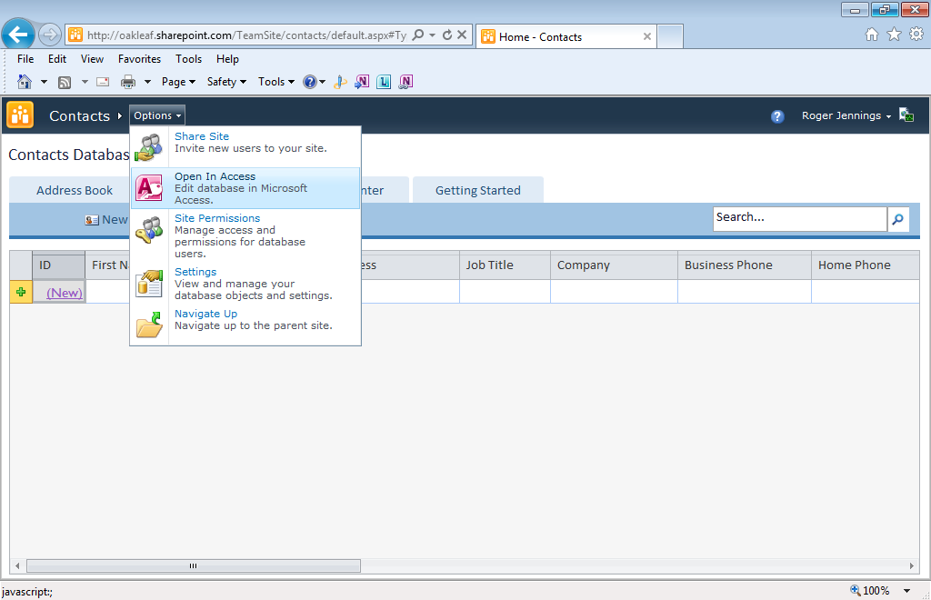
The Contacts Navigation Form
Notes:
The only page that’s accessible from the TeamSite/contacts sub-site is the Contacts navigation form, which is empty at this point. The Options menu offers Share Site, Open In Access, Site Permissions, Settings and Navigate Up choices.

Slide 41
Opening the Web Database in Access
Click the Options menu’s Open in Access choice.
Click Internet Explorer’s Save button to save the *.accdw file in your local Downloads folder:
Copy or move the *.accdw file to a Documents folder.
Select the Microsoft Access Web App Reference (*.accdw) file type in the Open dialog and open it.
Click OK and log in to Office 365 to open the *.accdw file in Access 2010 to print reports, edit data or change form or report designs.
Notes:
You can’t easily automate the process of adding contact items in bulk from SharePoint, so using Access to append new entries to the Contacts list from the GroupPol database is the better choice.

Slide 42
Initial Access Instance is Read-Only
A bug in SharePoint Online or Access 2010 causes a “This database was
connected to a Microsoft Access Services site that is not compatible with
this version of Microsoft Access. You cannot make design changes or modify
data in this database.”
Initial synchronization with the SharePoint Web Database generates a local
copy in your \Documents\Access Applications folder. In this case, the filename
is contacts on oakleaf.sharepoint.com.accdb. To avoid the Security Warning,
make the \Documents\Access Applications folder a trusted location.
Notes:
This issue appears to me to be a bug that, hopefully, will be removed in SharePoint 2010 SP1.

Slide 43
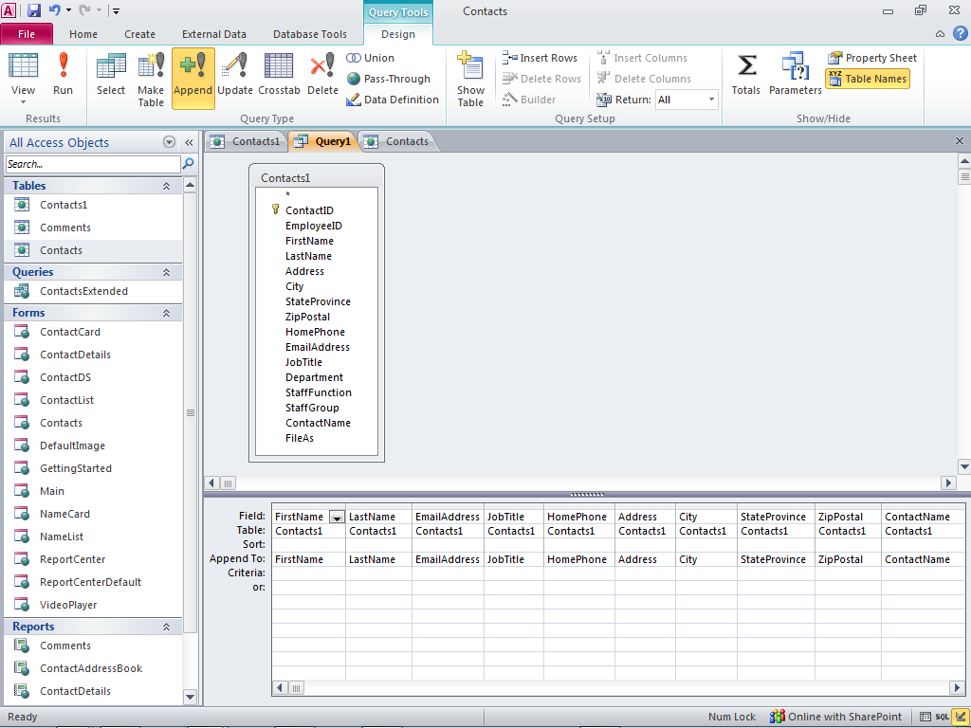
Append Contacts with a Client Query
Notes:
Open the GroupPol.accdb database, click the Create tab, open the Queries group’s Client Queries menu, and choose Query Design to open the Query Tools Design tab and the Query1 window. Query types other than Select are available for Web Databases only when you specify Client Queries. Add the Contacts1 table and drag the fields that match column names in the Contacts list to the grid. Click Run and confirm the operation to add 2,275 items to the Contacts list.

Slide 44
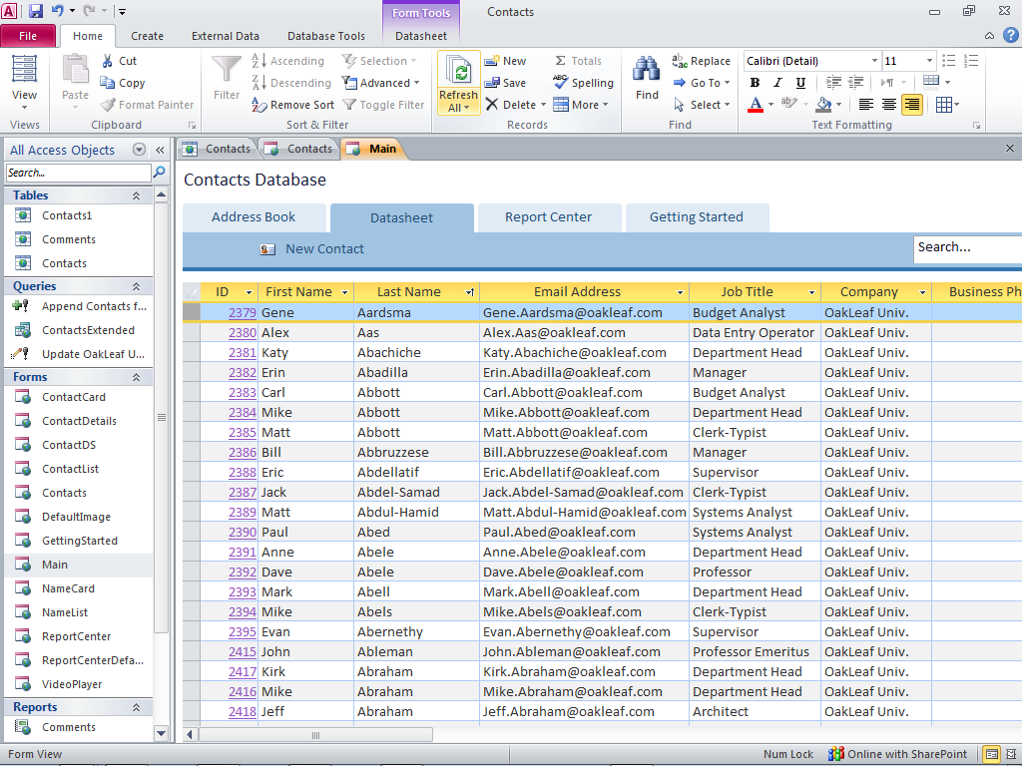
The Contacts Datasheet in Access
Notes:
Here’s the first few GroupPol Contacts1 items appended to the Contacts list. ID values are greater than 2,275 because I appended the items and deleted them, and then appended them again. Deleting list items in bulk is even slower than appending them.

Slide 45
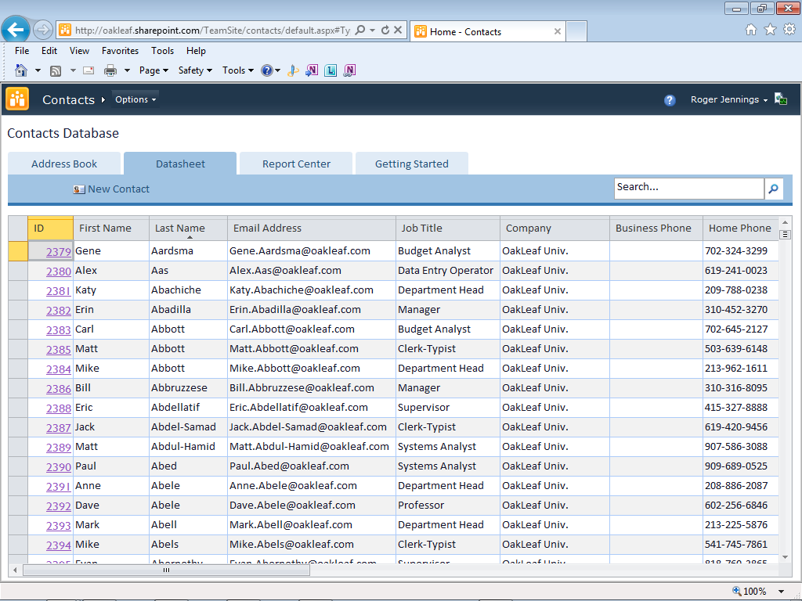
The Contacts Datasheet in SharePoint
Notes:
The appearance of the Contacts datasheet in SharePoint is quite similar to it’s Access cousin.

Slide 46
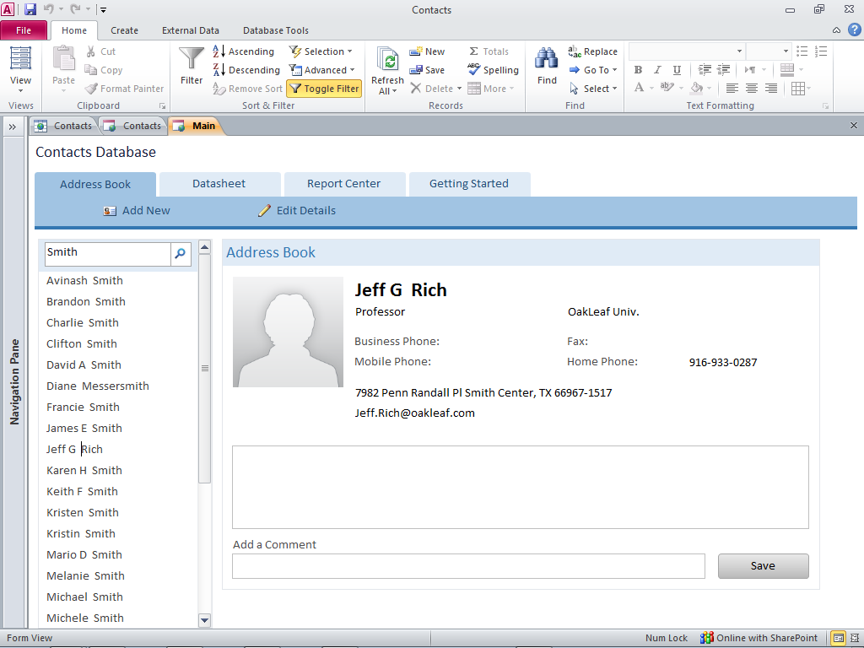
The Address Book in Access
Notes:
Search operates on the cached copy of the list, so it’s quite fast. Jeff Rich shows up in a search on Smith because he lives in Smith Center, Texas.

Slide 47
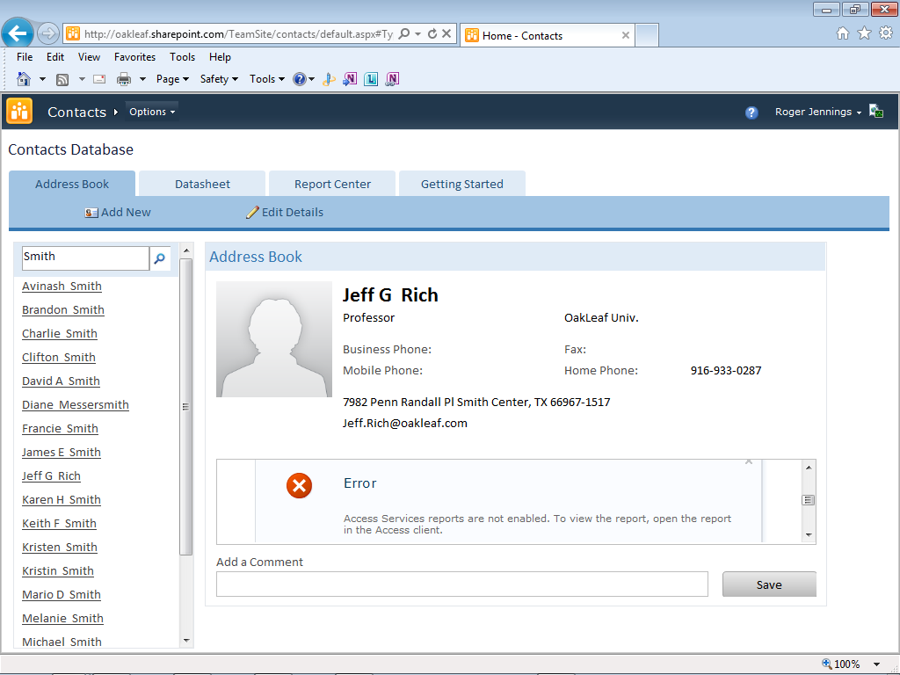
The Address Book in SharePoint
Notes:
The Comments report added as a subform to the ContractCard form of the Address Book throws an error because the current version of SharePoint Online’s Access Services doesn’t support reports. I provide a workaround for SharePoint Server 2010’s inability to print reports directly near the end of the Webcast.

Slide 48
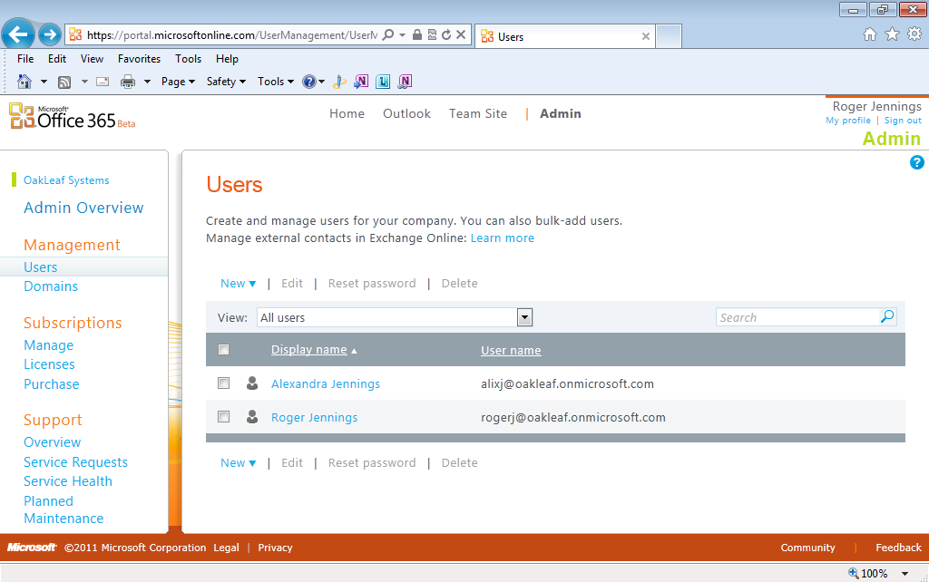
Adding Site Users
Open the Admin portal, click Users to open this page, and click New.
Notes:
My wife, Alexandra, and I were the only two users of the SharePoint Online site when I started recording this Webcast and both of us are administrators. You add new users with the Administrative portal’s Management feature. You can add users in bulk by creating a comma-separated-values file with Excel.

Slide 49
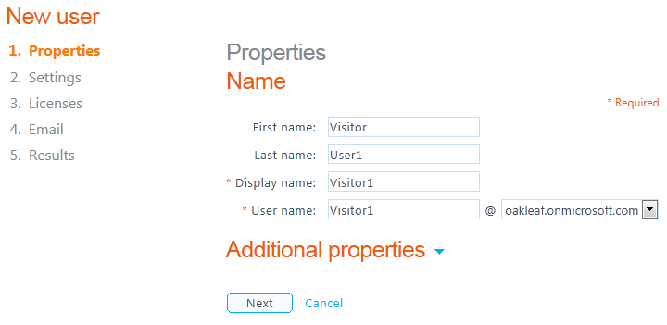
Setting New User Properties - 1
Add the user’s name and display name:
Notes:
There are five steps to set user property values. Additional properties let you add Job Title, Department, Office Number, Office and Home phone, fax number, and address information for the contact. Click Next to continue.

Slide 50
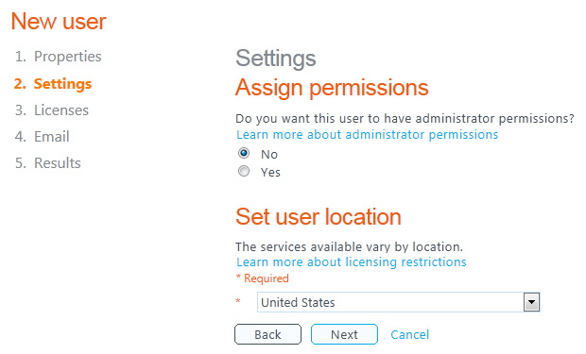
Setting New User Properties – 2
Assign administrator permissions, if necessary, and
specify the country in which the user is located.
Notes:
Step 2 lets you specify administrative permissions for the new user and his or her location by country.

Slide 51
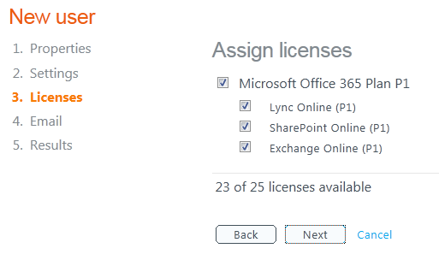
Setting New User Properties – 3
Each beta user requires one of the 25 Office 365 licenses granted when you signed up for the beta:
Notes:
Step 3 requires that you assign new users a subscription (that is, license) for Office 365 Small Business Edition Plan P1. Alexandra and I consumed the first of 25 licenses included in the Office 365 beta program.

Slide 52
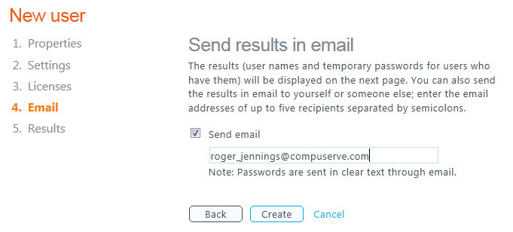
Setting New User Properties - 4
Type the new user’s email address or use yours to test the process:
Notes:
Step 4 lets you send an email notice with the username and temporary password to anyone you choose, but normally you send the message to yourself to confirm the operation and then forward the message to the new user. You’ll see a sample message shortly.

Slide 53
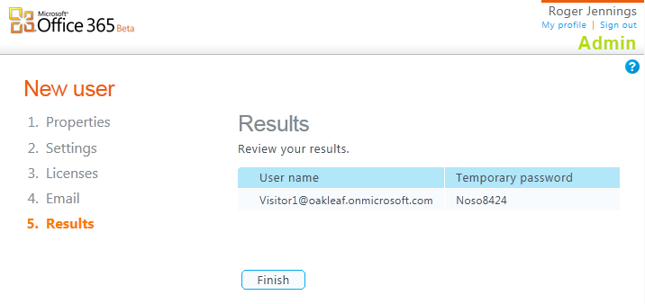
Setting New User Properties - 5
Click Finish to view all users’ account data:
xxxxxxx Redacted
Notes:
The fifth screen confirms the user name and temporary password.

Slide 54
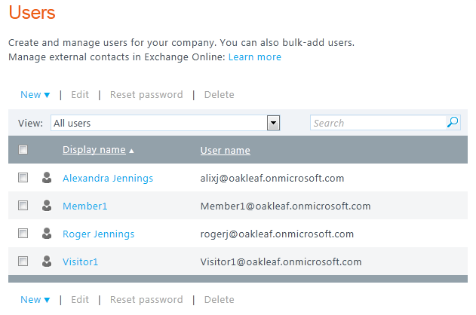
Reviewing New Users
Notes:
The final step is to review each new user you add.

Slide 55
Assign User Permissions
The administrative user account you receive when subscribing to Office 365 has Full Control permissions. Available permissions for others are:
Full Control - Has full control of objects (Owners)
Design - Can view, add, update, delete, approve and customize
Contribute - Can view, add, update and delete list items and documents (Members group)
Read - Can view pages and list items, as well as download documents (Visitors group)
View Only - Can view pages, list items and documents (Viewers group)
Notes:
You can assign users to one or more of SharePoint’s built-in, non-administrative groups.

Slide 56
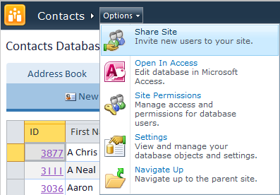
Share the Sub-Site with New Users
Return to the sub-site (Contacts for this example)
and choose Share Site from the Options menu:
Notes:
Selecting the Share Site menu choice opens the Share Your SharePoint Site dialog.

Slide 57
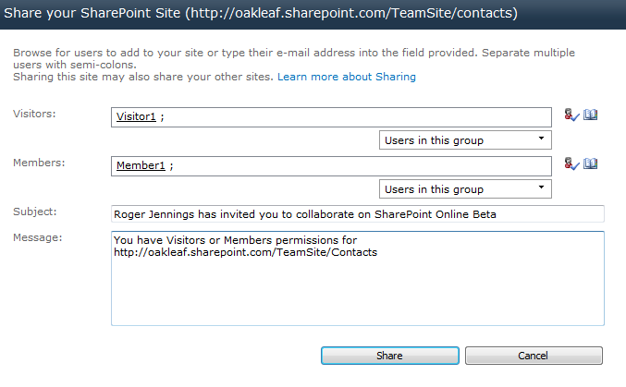
Assign New Users to the Sub-Site’s Visitors and Members Groups
Assign new users to the appropriate built-in group:
Notes:
The Share Your SharePoint Site dialog automates the process of adding users to Visitors and Members groups. Type the names of the users you added, separated by semi-colons, and click the check icon to verify the users’ existence. Click Share to send messages to the email alias you specified earlier.

Slide 58
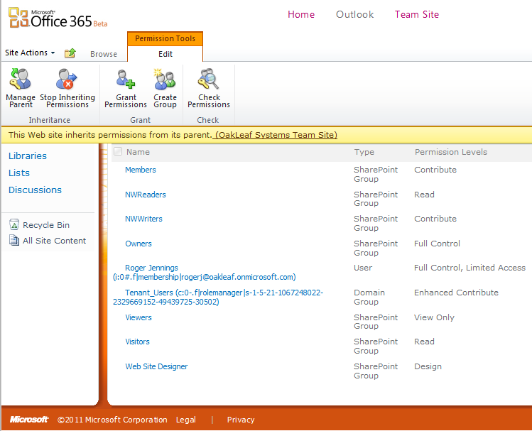
Verifying Permissions

Slide 59
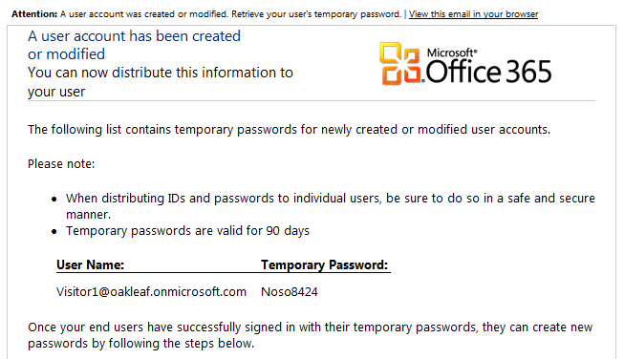
Typical Message to an Admin - 1
XXXXXXX Redacted
Notes:
The administrator who added the user and assigned permissions receives this message confirming the account has been created. This is the top half.

Slide 60
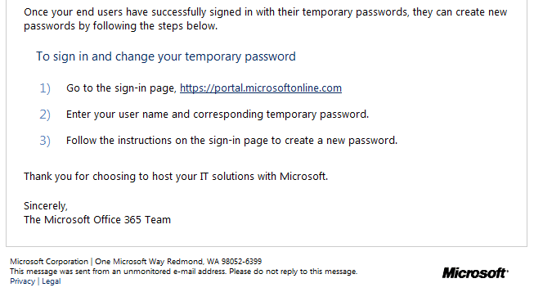
Typical Message to an Admin - 2
Notes:
The bottom half has initial log-in procedures for the user.

Slide 61
Work-Around for Known Printing Bug
There is a known bug in one of the Web Database components of SharePoint 2010 that causes reports to print empty pages or pages with scrollbars instead of the expected report.
Office Service Pack 1 probably won’t correct this problem.
Access 2010’s Northwind Web Database template has an option to open a report in its own tab.
To work around the issue, open the report in its own tab, export the report to a *.PDF file and print it.
The next slide shows part of the Customer List’s first page printed from CustomerList.pdf.
Notes:
The workaround for the printing bug in Web Databases opened in Access 2010 isn’t complex, but it’s curious that the Access team didn’t fix it in Service Pack 1. If you don’t display the report in its own tab, the *.PDF file will contain headers without data entries.
The Web Database you create from Access 2010’s Northwind Web Database template contains an example of a macro to display and print reports.
This workaround doesn’t apply to Web Database reports created with SharePoint Online. This probably will be fixed in a later Office 365 Service Pack.

Slide 62
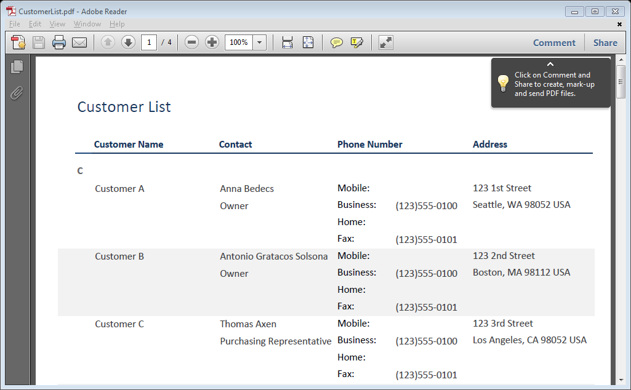
Customer List Report PDF Export
Notes:
Here’s the PDF printout of the Customer List report.

Slide 63
An Alternative to SharePoint Online
Access Hosting (http://AccessHosting.com) is a managed service provider offering multi-tenanted SharePoint with Access Services via the Internet:
30-day free trial account
Developer account: 1 user, 20 MB storage, US$19/month
Standard account: Up to 5 users, 1 GB storage, US$49/month
Enterprise account: Up to 10 users, 2 GB storage, US$99/month
5 additional user accounts, US$29.95/month
1 GB additional storage, US$49.95/month
Notes:
If you’re only interested in using SharePoint for linked tables or Web databases and don’t plan to use the other online features of Office 365, you might find Access Hosting’s multi-tenanted service an attractive alternative. When you consider that each Office 365 user will cost $6.00 per month for a Small Business subscription, the surcharge for Standard or Enterprise Accounts isn’t significant. Additional user accounts cost the same as Office 365 Small Business subscriptions. Access Hosting backs up all data daily and provides FTP access to backed-up files. Access Hosting also offers an automated conversion service for migrating conventional Access 2007 and 2010 databases to hosted Web Databases.
My first Webcast in this series, Upsizing Access 2010 Projects to Web Databases with SharePoint 2010 Server, provides detailed instructions for creating Web Databases that run on Access Hosting’s servers.

Slide 64
For More Info about Web Databases
See Microsoft Access 2010 in Depth, Chapter 23
Check out March 2010 postings to my Access in Depth blog at http://accessindepth.blogspot.com:
SharePoint 2010 Lists’ OData Content Created by Access Services is Incompatible with ADO.NET Data Services
Upsizing the Northwind Web Database to an Updated SharePoint 2010 Server Hosted by AccessHosting.com
Access Web Databases on AccessHosting.com: What is OData and Why Should I Care?
Access Web Databases on AccessHosting.com: Adding User Logins and Assigning Permissions
Three Microsoft Access 2010 Webcasts Scheduled by Que Publishing for March, April and May 2011
Notes:
My book’s Chapter 23 has detailed instructions for creating and deploying Web databases to hosted and on-premises services. The chapter also explains how to install SharePoint Server 2010 Enterprise Edition to Windows 2008 R2 Server.

Slide 65
Check Out My Previous Webcasts
Upsizing Access 2010 Projects to Web Databases with SharePoint 2010 Server. Access 2010 introduces the capability to easily publish Access *.accdb applications to Web Databases that run on SharePoint Server 2010’s Access Services.
Linking Access tables to on-premise SQL Server 2008 R2 Express or SQL Azure in the cloud. Microsoft SQL Server has been the preferred back-end database for heavy-duty, multiuser Access applications since Access 2000 introduced the capability to link to the Microsoft Data Engine (MSDE).
Thanks for Watching!

Slide 66
Feedback Wanted
Help us make the Que Webcast series more useful
for your Microsoft Access learning needs.
Complete the post event survey and be registered
to win a FREE book of your choice from Que.
Three (3) winners will be selected from all
completed surveys 2 days after event live date.

Slide 67
Visit quepublishing.com/jennings for Roger Jennings Books and Articles
SPECIAL DISCOUNT!
Save 35% on
Books & eBooks
by Roger Jennings
Use coupon code JENNINGS at checkout to receive your discount.

Slide 68
Thank you.
Expect an e-mail with information on how you can
access the recorded session and survey link.
Sign-up for More Que Webcasts @
quepublishing.com/webcasts
Connect with Que Publishing on:

